Slide 1

Molding Machine Dashboard
Group 19
E/18/022 Amarasinghe D.I.
E/18/154 Jayasumana C.H.
E/18/349 Thalisha W.G.A.P.

Slide 2


Problem Domain and Solution
Key Features
Content
Solution Architecture
System Overview
Demonstration

Slide 3

Problem Domain and Solution
? stuck plastic problem
Plastic residue gets stuck or left behind in the mold
Reduces the efficiency of the machines
What if we had a method to identify the inefficient machines at a glance?

Slide 4

Our Solution
Molding Machine Dashboard

Slide 5
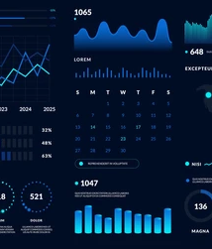
What is Molding Machine Dasboard?
It is a visual display of all data relevant to 25+ machines in a factory setting

Slide 6

Secure login system
Graphical representation of data
Key Features
Ability to generate reports
Ability to update the database through the dashboard

Slide 7

Molding Machine Dashboad
Solution Architecture

Slide 8




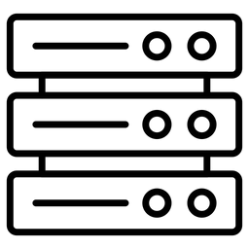
Flow of Data
GET/POST/
PUT/DELETE
JSON/ XML
Backend
Frontend

Slide 9
Technology Stack
FrontEnd
React.js
Express.js
API
Node.js
BackEnd
MySQL

Slide 10

Molding Machine Dashboad
System Overview

Slide 11
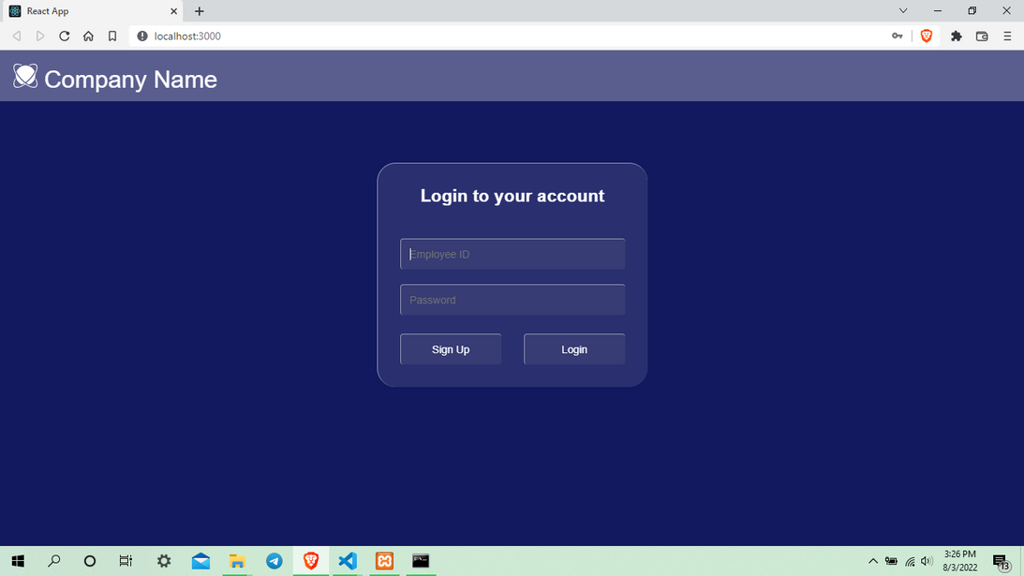
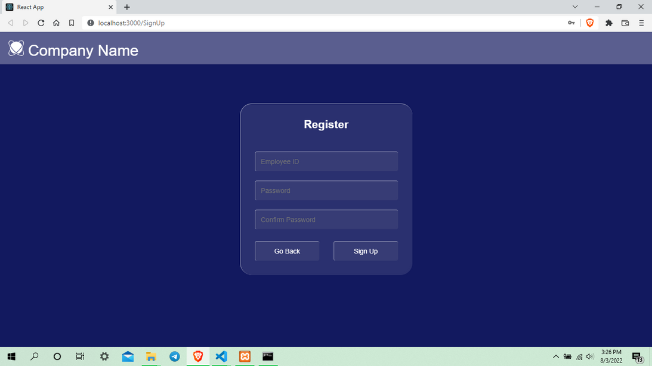

User Interfaces and Functionalities
CONTENT
Login and signup

Slide 12
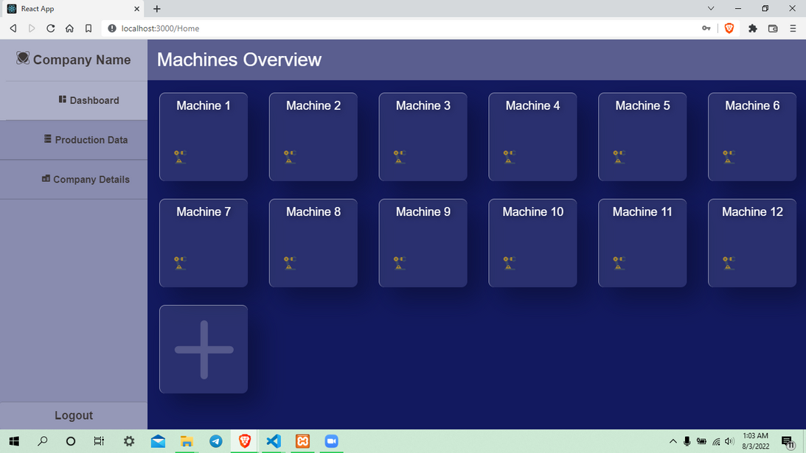
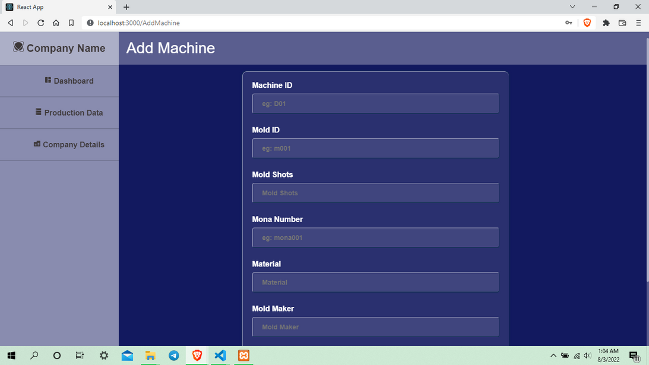
Machine overview
Add machine
CONTENT

Slide 13
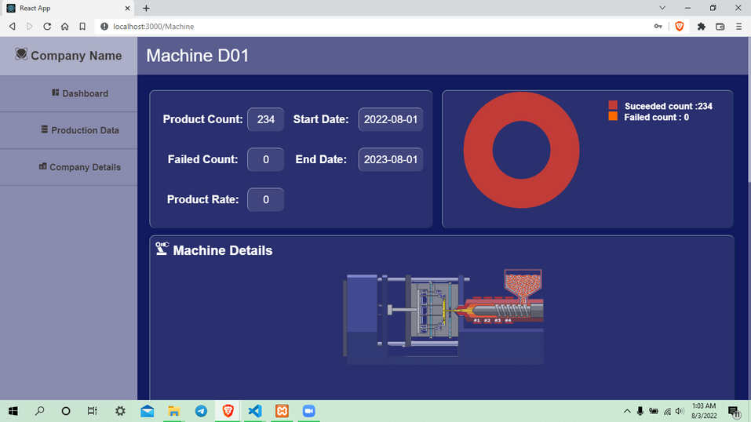
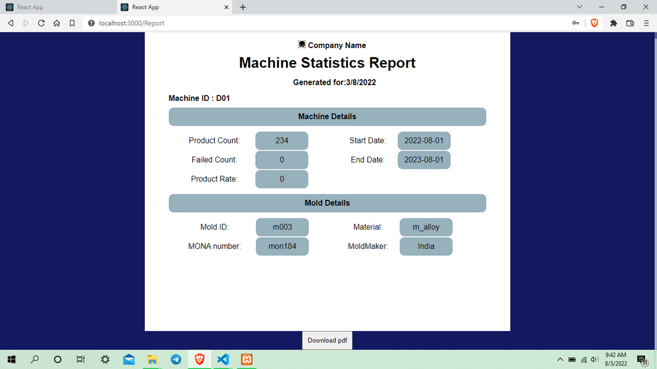
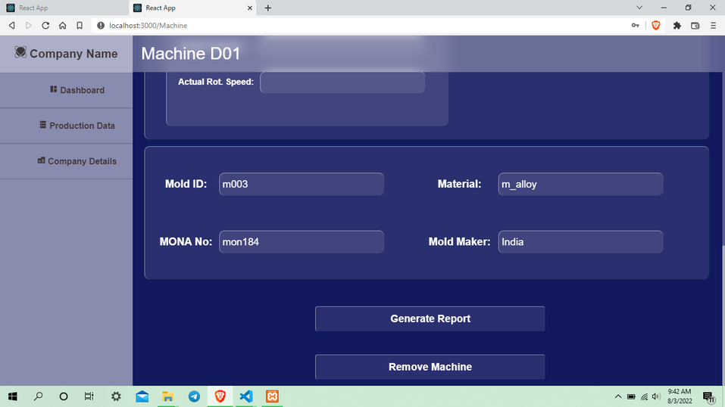
View machine details
Machine report generation
CONTENT
Remove the current machine

Slide 14
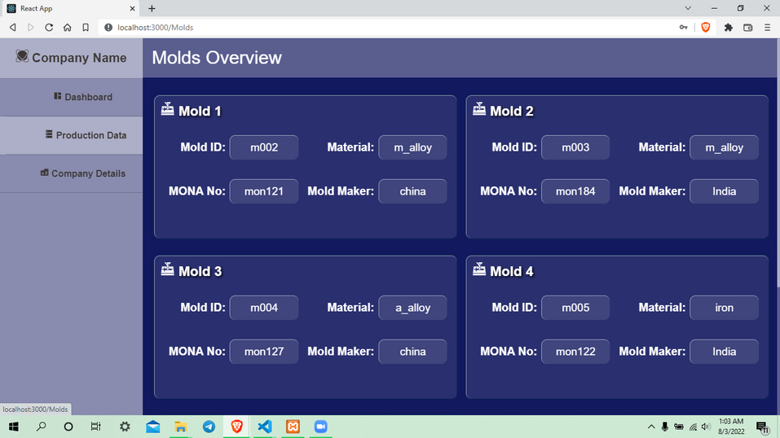
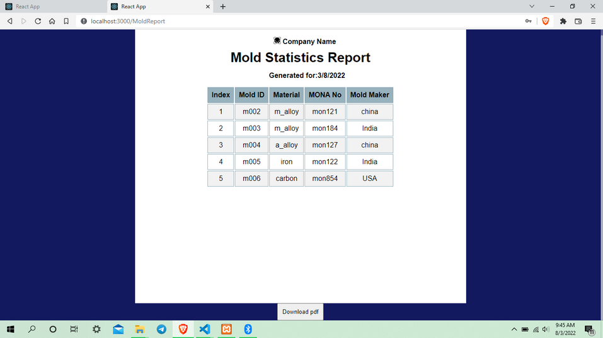
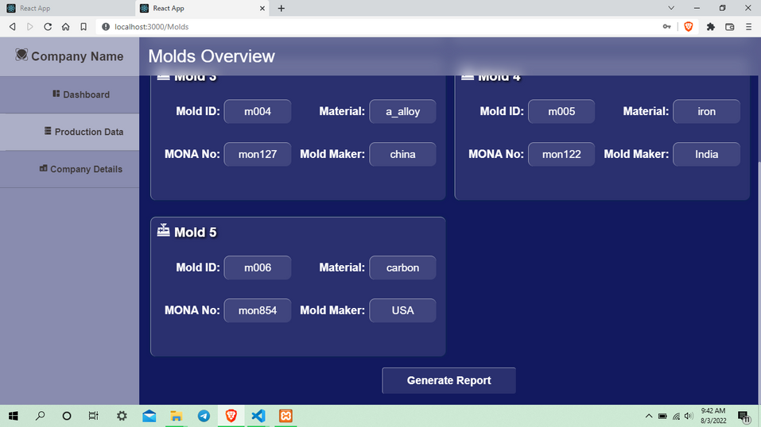
Molds Overview
Mold report generation
CONTENT

Slide 15
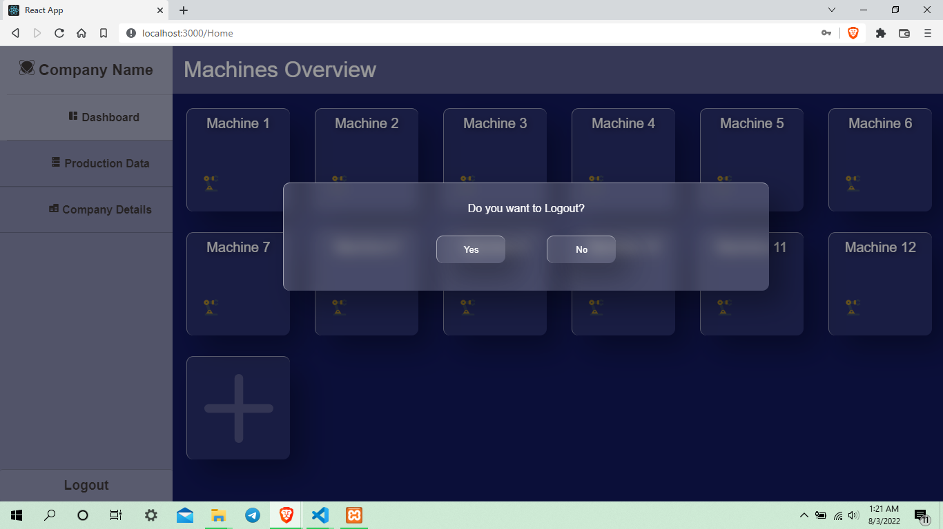
Logout

Slide 16
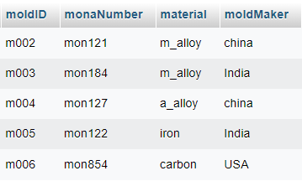
BackEnd Database
Molds table

Slide 17
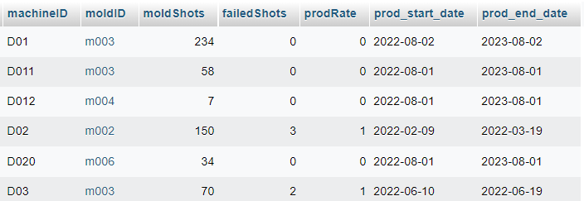
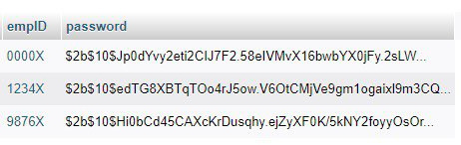
Machines table
Passwords table

Slide 18
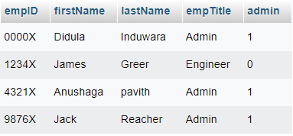
Employees table

Slide 19
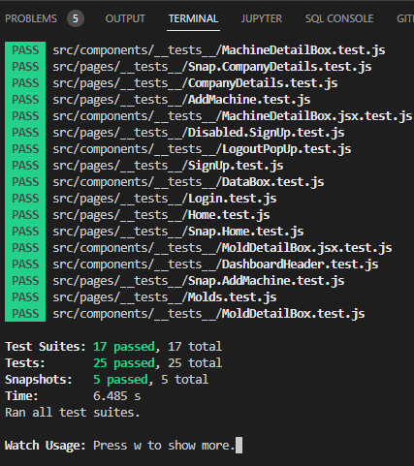

TESTING
Unit Testing
Render without errors
no JSX syntax errors
It must render
Test the states
Test the events
enabled/disabled
success/warning/error
onClick events
button/input
react-testing-library

Slide 20
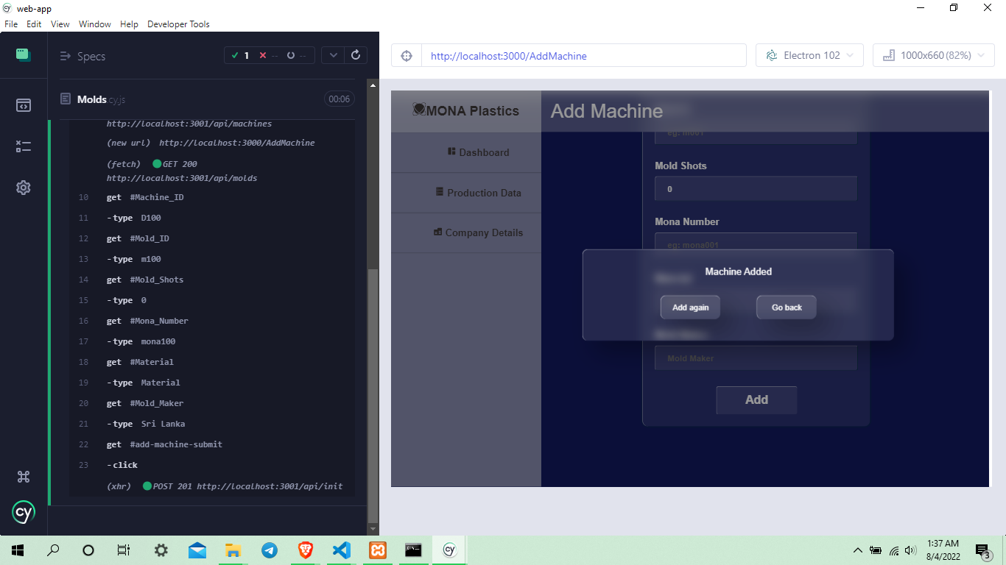
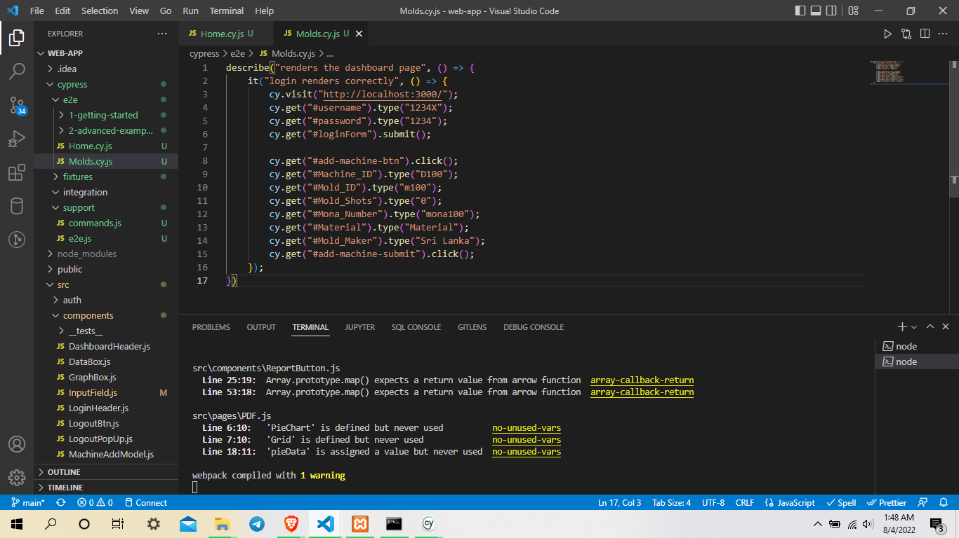
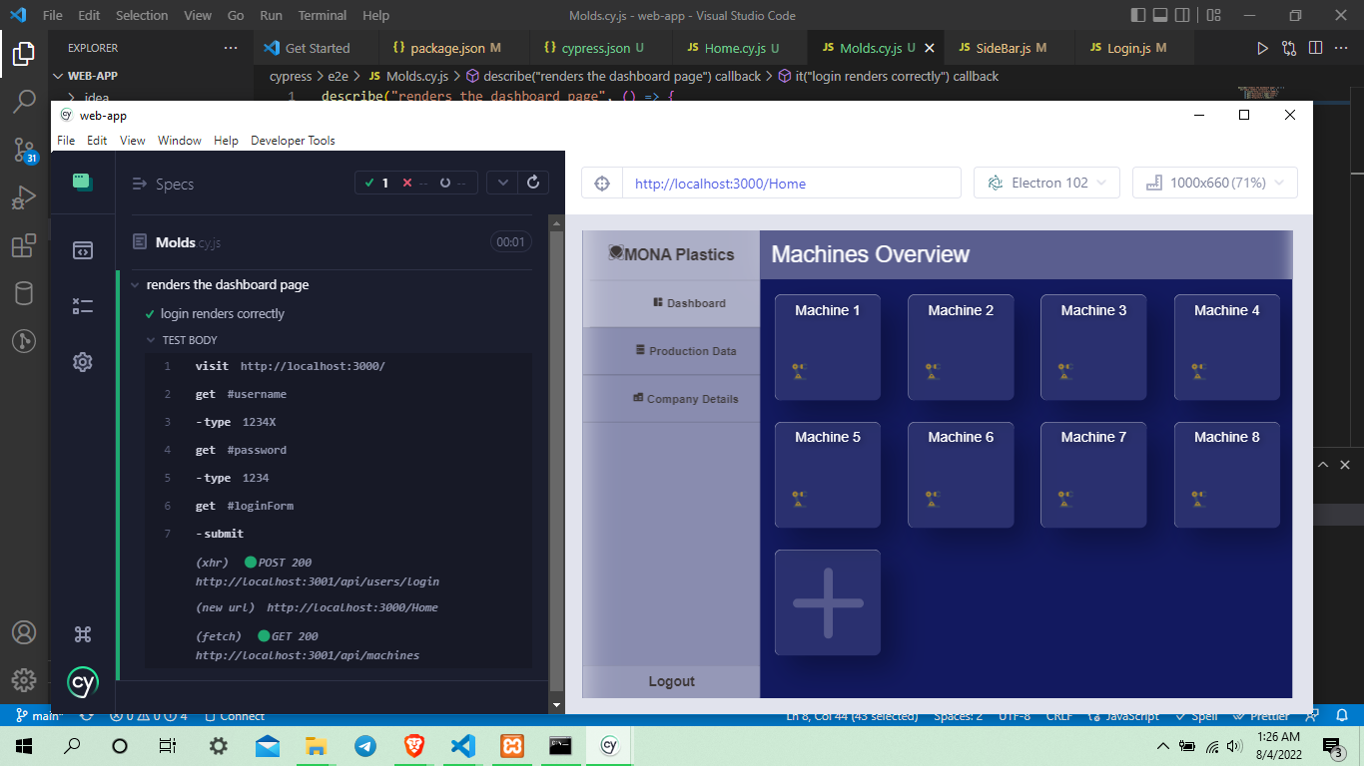

TESTING
E2E (UI) Testing

Slide 21

Molding Machine Dashboad
Demonstration

Slide 22

Molding Machine Dashboad
Q & A

Slide 23

Molding Machine Dashboad
Thank You

